Slide 1


BASE DE DONNÉES POKEMON

Slide 2
SOMMAIRE
workbench
Constraints
Engine
References
Foreign Key
Unique Index

Slide 3
WORKBENCH

Slide 4
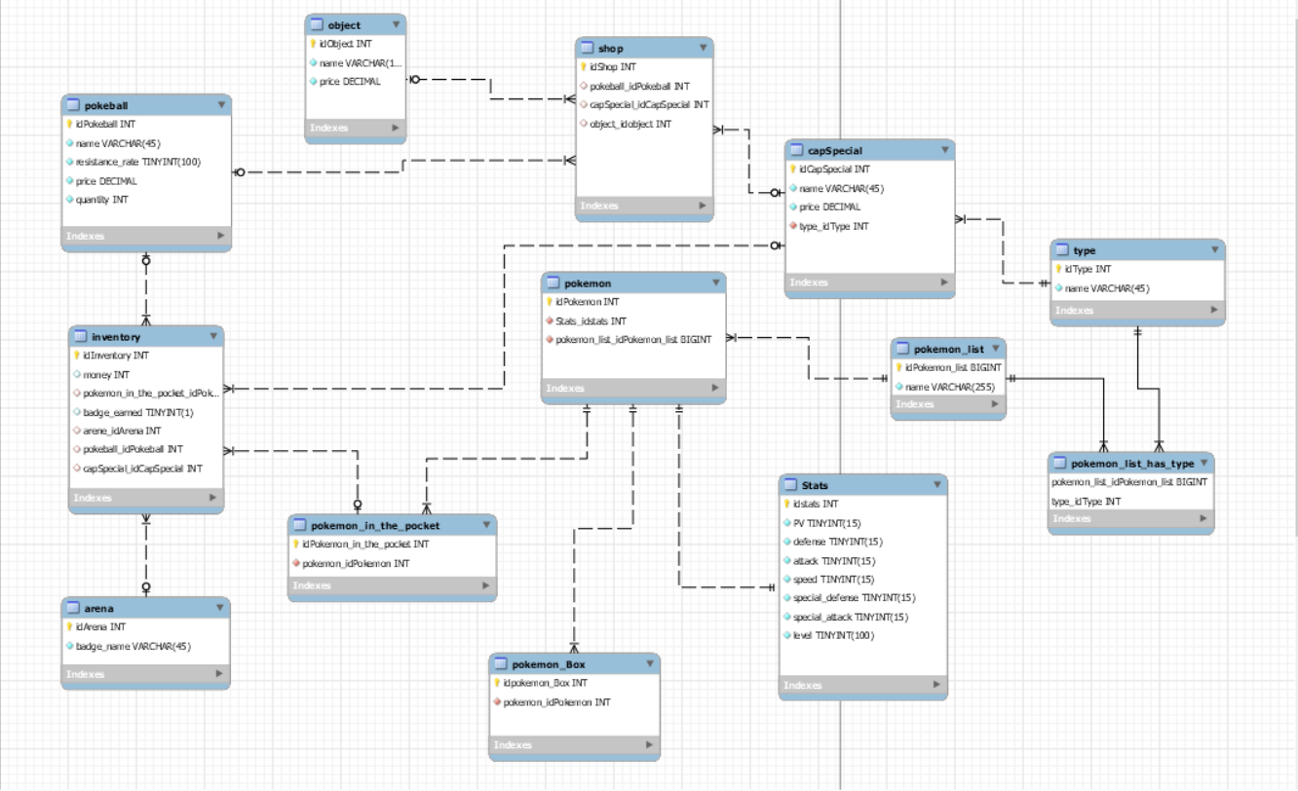

Slide 5


Slide 6
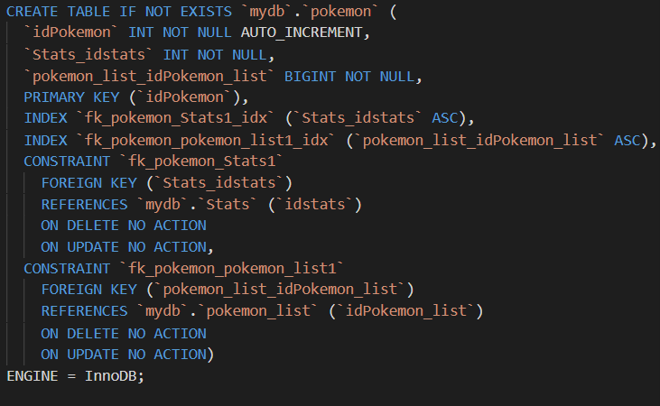
SCRIPT

Slide 7
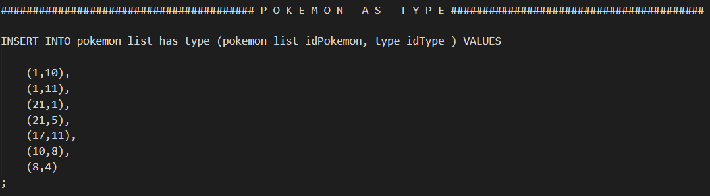
REQUETE

Slide 8
PYTHON DEMO

